Slide 1
Development of V2g communication and control System
Course Project in the Course Titled
EN 663: Electric Vehicle Grid Integration
Name: Soham Deepak Koyande
Roll No.: 21D170040
Course Instructor: Prof. Zakir Hussain Rather
Date of Presentation: 9th November 2024

Slide 2
Objectives completed
A detailed analysis reviewing existing V2G communication protocols and standards, highlighting current capabilities and limitations.
A fully documented V2G communication architecture tailored to meet ISO 15118 standards, accompanied by implementation guidelines.
Advanced control algorithms specifically engineered to enhance EV interaction with the distribution grid, focusing on stability and efficiency. (load balancing {selected this grid service for this project}, voltage regulation or congestion management).
A fully functional simulation environment setup demonstrating the integration and operation of the V2G system
Detailed test results from simulations conducted for both summer and winter scenarios, offering insights into the system’s performance under various conditions.

Slide 3
Contents
S. No. | Content | Page No.
1. | Objectives completed | 2
2. | Contents | 3
3. | Understanding Standards in V2G | 4
4. | Commonly Used Protocols | 5
5. | ISO 15118 Message Sequence | 6
6. | Parameters and Assumptions in Simulation | 7
7. | Algorithm | 8
8. | Results | 9 - 13
9. | Validation | 14
10. | Inferences on Results | 15
11. | Features and Improvements | 16
12. | References | 17

Slide 4
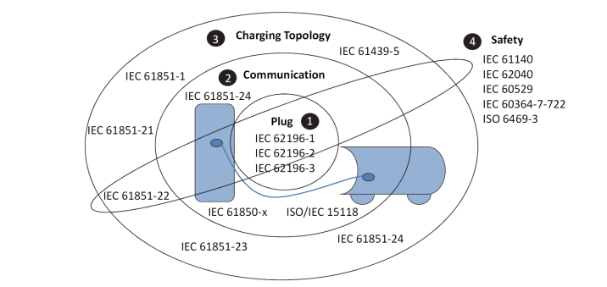
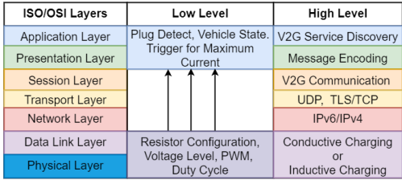
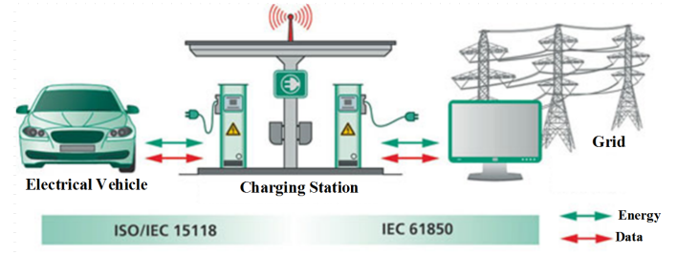
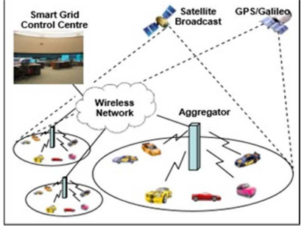
Understanding Standards in V2G
21
1. Shom, S., Guha, A., Tsang, K. F., Nishi, H., Wu, C. K., Shuaib, K., Sharif, H., & Alahmad, M. (2022). Survey of Protocols for V2G communications. 2022 IEEE International Conference on Industrial Technology (ICIT). https://doi.org/10.1109/icit48603.2022.10002733
2. Vadi, S., Bayindir, R., Colak, A. M., & Hossain, E. (2019). A Review on Communication Standards and Charging Topologies of V2G and V2H Operation Strategies. Energies, 12(19), 3748. https://doi.org/10.3390/en12193748
3. K, S., & M, M. S. R. P. D. (2023c). A Comprehensive Study on the Communication Protocols for V2G Operations. IEEE. https://doi.org/10.1109/pesgre58662.2023.104049

Slide 5
Commonly used protocols
Standard | Front End(FE)/Back End (BE) | Openness | Interoperability | Maturity | Market adoption | Gaps
IEC 61851 | FE | High | High | High | High | Strategies
ISO 15118 | FE | High | High | Medium | Low | Real time schedule
CHAdeMO | FE | Medium | Medium | High | High | Security
OCPP | BE | Medium | High | High | High | Bidirectional Power Flow
IEC 63110 | BE | High | High | Low | Low | At early stage
OpenADR | BE | High | Medium | High | Medium/High | Alignment with other protocols
IEEE 2030.5 | FE/BE | High | Medium | High | Low | Less use cases
EEBUS | BE | Medium/High | - | Low | Low | Program Guides not available
Neaimeh, M., & Andersen, P. B. (2020). Mind the gap- open communication protocols for vehicle grid integration. Energy Informatics, 3(1). https://doi.org/10.1186/s42162-020-0103-1

Slide 6
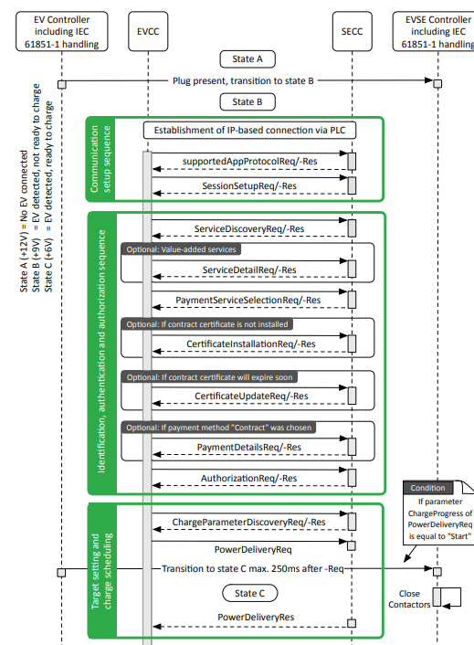
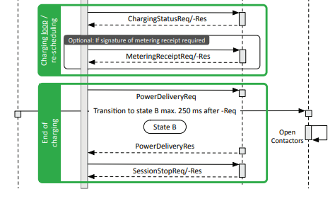
ISO 15118 Message sequence
to find if bidirectional is offered by SECC
Other messages and parameters required:
AC EVBidirectionalParameter
AC BidirectionalControlReq/-Res
EVSETargetActivePower
EVSETargetReactivePower
EVSETargetFrequency
To find boundary parameters
Multin, M. (2018). ISO 15118 as the Enabler of Vehicle-to-Grid Applications. IEEE. https://doi.org/10.23919/eeta.2018.8493213

Slide 7
Max Charging and Discharging Powers
PARAMETERS AND ASSUMPTIONS IN SIMULATION
Duration of Connection
Battery Capacity
Simulation conducted using the following assumptions:
1,00,000 V2G compatible EVs
All EVs are assumed to participate in grid services.
Final SOC = 80 %.
Maximum charging and discharging rates are same
P_ev can be controlled in step size = 5. Assumed same for charging and discharging
Initial SOC
Participate
in Grid Service ?
Final SOC
Algorithm
 | SOC (%) | Time Connected (hours) | Maximum Power (kW) | Battery Capacity (kWh)
Range of Values | [20, 60] | [6, 10] | [4, 30] | [30, 100]
Distribution Type | Uniform | Uniform | Normal | Normal
Mean | 40 | 8 | 17 | 65
Standard Deviation | - | - | 8 | 15
P_ev
SOC
Balanced Load Profile

Slide 8
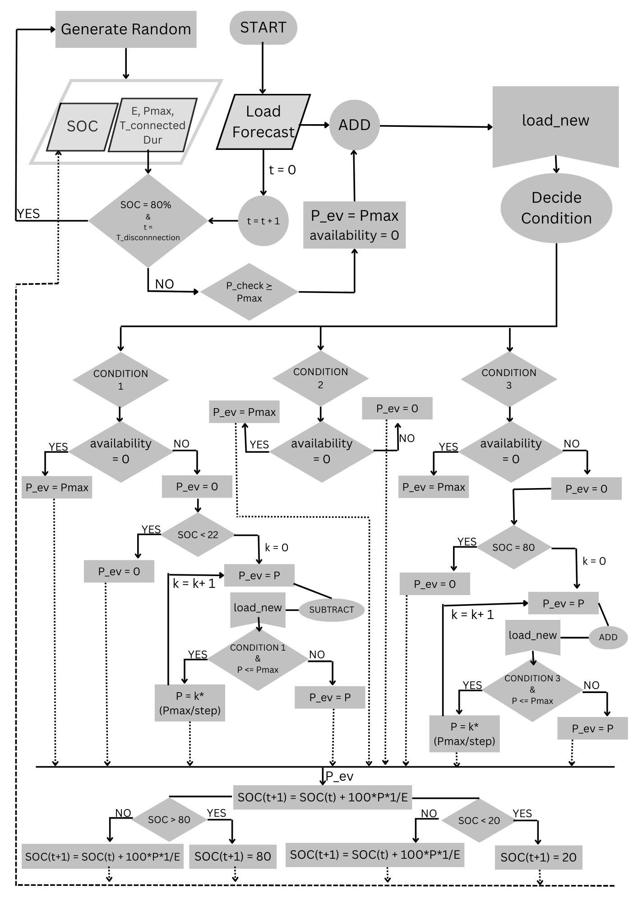
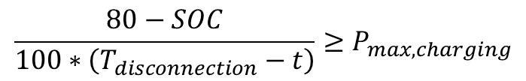

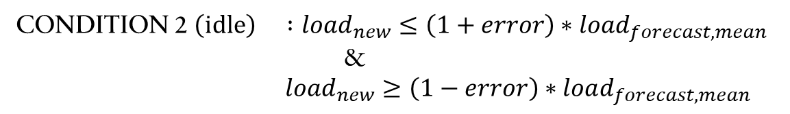
ALGORITHM
# To ensure that 80 % SOC is reached before the user comes back, EV is charged irrespective of the time of day. Its load is added to the load forecast to form a new load (load_new). The following criteria is used:
$$\frac{80−SOC}{100∗\left(T_{disconnection}−t\right)}≥P_{max, charging}$$
# If SOC = 80 %, and the time of disconnection is achieved, the algorithm parameters corresponding to the EV are updated randomly according to the assumptions, to simulate the a new charging session started by a new user.
CONDITION 1 (discharge) : $load_{new}>\left(1+error\right)∗load_{forecast, mean}$
CONDITION 2 $\left(idle\right) :load_{new}≤\left(1+error\right)∗load_{forecast, mean}$
&
$load_{new}≥\left(1−error\right)∗load_{forecast, mean}$
CONDITION 3 (charge) $: load_{new}<\left(1− error\right)∗load_{forecast, mean}$
$$SOC\left(t+1\right)=SOC\left(t\right)+(\frac{P∗1}{E})∗100$$
# If this SOC is greater than 80 %, it is capped at 80 % to simulate charging has stopped. If it is less than 20 %, then it is capped at 20 % to simulate that discharging has reached its limit and stopped.

Slide 9
RESULTS
Load Forecast Data was taken from NITI Aayog’s India Climate and Energy Dashboard. It provided load data on an hourly basis.
https://iced.niti.gov.in/energy/electricity/distribution/national-level-consumption/load-curve

Slide 14
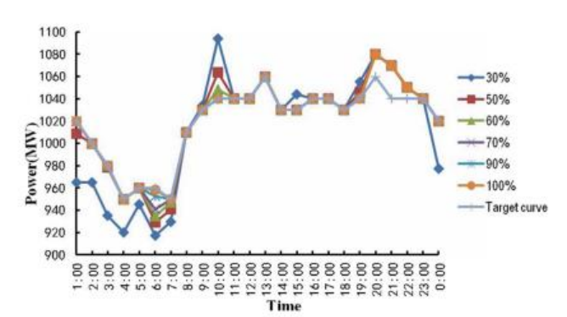
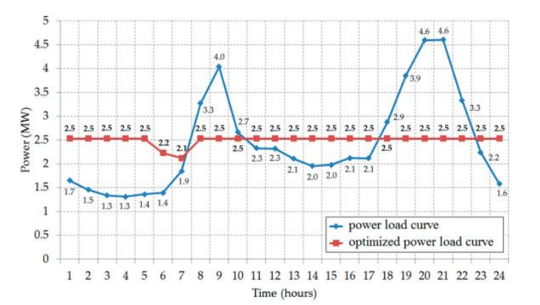
7.
VALIDATION
The papers (their results shown on the left), conducted their simulation using the following:
Only for 24 hours
Conducted an optimisation problem solution with constraints on maximum and minimum SOC, and duration of charging session, but did not consider the constraint of providing the user input SOC at the end of session.
They decided on a target load curve before doing the study.
The optimisation found the best load balancing for different values of SOCs over the entire fleet of EVs.
Did not capture the dynamic ending and starting of sessions and so new users were not considered.
8.
7. Wang, Z., & Wang, S. (2013). Grid Power Peak Shaving and Valley Filling Using Vehicle-to-Grid Systems.
IEEE Transactions on Power Delivery, 28(3), 1822–1829. https://doi.org/10.1109/tpwrd.2013.2264497
8. Tan, K. M., Ramachandaramurthy, V. K., Yong, J. Y., Padmanaban, S., Mihet-Popa, L., & Blaabjerg, F. (2017). Minimization of Load Variance in Power Grids—Investigation on Optimal Vehicle-to-Grid Scheduling. Energies, 10(11), 1880. https://doi.org/10.3390/en10111880
RESULT OF THE SIMULATION IN THIS PROJECT

Slide 15
Inferences on results
The load balancing achieved in Delhi is much better than in Maharashtra. This is because the total load in Maharashtra is of the order of tens of thousands of MW, whereas in Delhi it is in thousands of MWs. This happened due to applying the same number of EVs in both scenarios (i.e. 100,000). The number of EVs could not be increased further in the simulation of Maharashtra due to computation time constraints.
These are not observed in the Summer conditions, because the daytime and nighttime temperatures are almost identical (although still not as stable as Mumbai).
This comment on peaks can be explained by point 1 in the case of Maharashtra, but cannot be explained by the weather conditions because the weather distribution is variable throughout the landmass of Maharashtra.
In each of the cases, the EV SOC reaches 80% at regular intervals, closely corresponding to the duration mentioned by the user (in this case, by the vector ‘T_connectedDur’. So, the requirements of EV users are fulfilled along with providing grid services.

Slide 16
Features and IMPROVEMENTS
FEATURES
User requirements of full charge at the end of charging session are met.
Achieves load balancing without going above the original load forecast at any time.
Power limits of the EVs are followed.
A new user is connected when one user’s charging session is complete.
Ensures maximum participation in grid services while respecting the SOC limits of the EV.
Can observe the SOC and the power supplied by/ given to the grid for each charger in the simulation.
IMPROVEMENTS
It was assumed that all EV users agree to the grid service participation. This could be included by allowing for a ‘participation’ parameter, which only allows the CHARGE or IDLE state of the EV.
The SOC at the end of charging was assumed to be 80 % for each user, but it could be simulated by allowing for a random SOC as a simulation of the SOC input by the user.
Some EV charge points do not reach 80% in the simulation. The number of these occurrences are very less compared to the number of EVs in the simulation (n = 100,000).
The number of steps taken while selecting a power set point could be made different for each EV.

Slide 17
References
Shom, S., Guha, A., Tsang, K. F., Nishi, H., Wu, C. K., Shuaib, K., Sharif, H., & Alahmad, M. (2022). Survey of Protocols for V2G communications. 2022 IEEE International Conference on Industrial Technology (ICIT). https://doi.org/10.1109/icit48603.2022.10002733
Vadi, S., Bayindir, R., Colak, A. M., & Hossain, E. (2019). A Review on Communication Standards and Charging Topologies of V2G and V2H Operation Strategies. Energies, 12(19), 3748. https://doi.org/10.3390/en12193748
K, S., & M, M. S. R. P. D. (2023c). A Comprehensive Study on the Communication Protocols for V2G Operations. IEEE. https://doi.org/10.1109/pesgre58662.2023.104049
Neaimeh, M., & Andersen, P. B. (2020). Mind the gap- open communication protocols for vehicle grid integration. Energy Informatics, 3(1). https://doi.org/10.1186/s42162-020-0103-1
Multin, M. (2018). ISO 15118 as the Enabler of Vehicle-to-Grid Applications. IEEE. https://doi.org/10.23919/eeta.2018.8493213
Niti Aayog India Climate & Energy Dashboard: https://iced.niti.gov.in/energy/electricity/distribution/national-level-consumption/load-curve Date accessed: 25th October 2024.
Wang, Z., & Wang, S. (2013). Grid Power Peak Shaving and Valley Filling Using Vehicle-to-Grid Systems. IEEE Transactions on Power Delivery, 28(3), 1822–1829. https://doi.org/10.1109/tpwrd.2013.2264497
Tan, K. M., Ramachandaramurthy, V. K., Yong, J. Y., Padmanaban, S., Mihet-Popa, L., & Blaabjerg, F. (2017). Minimization of Load Variance in Power Grids—Investigation on Optimal Vehicle-to-Grid Scheduling. Energies, 10(11), 1880. https://doi.org/10.3390/en10111880

Slide 18
Thank you !

